Slide 1
CSE 403
Lecture 24
Scrum and Agile Software Development
Reading:
Scrum Primer,
by Deemer/Benefield/Larman/Vodde
slides created by Marty Stepp
http://www.cs.washington.edu/403/

Slide 2
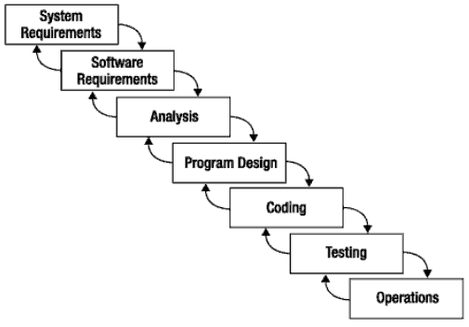
What is Scrum?
Scrum:
  Is an agile, lightweight process
  Can manage and control software and product development
  Uses iterative, incremental practices
  Has a simple implementation
  Increases productivity
  Reduces time to benefits
  Embraces adaptive, empirical systems development
  Is not restricted to software development projects
  Embraces the opposite of the waterfall approach…
It’s about common sense

Slide 3


Agile Manifesto
Individuals and interactions
Process and tools
over
Working software
Comprehensive documentation
over
Customer collaboration
Contract negotiation
over
Responding to change
Following a plan
over
Source: www.agilemanifesto.org

Slide 4

Project Noise Level
Far from
Agreement
Anarchy
Complex
Requirements
Complicated
Source: Strategic Management and Organizational Dynamics by Ralph Stacey in Agile Software Development with Scrum by Ken Schwaber and Mike Beedle.
Close to
Agreement
Simple
Technology
Close to
Certainty
Far from
Certainty

Slide 5
Scrum at a Glance
24 hours
Daily Scrum
Meeting
Backlog tasks
expanded
by team
30 days
Sprint Backlog
Potentially Shippable
Product Increment
Product Backlog
As prioritized by Product Owner
Source: Adapted from Agile Software Development with Scrum by Ken Schwaber and Mike Beedle.

Slide 6

Sequential vs. Overlap
Requirements
Design
Code
Test
Rather than doing all of one thing at a time...
...Scrum teams do a little of everything all the time

Slide 7
Scrum Framework
Roles
Product owner
Scrum Master
Team
Ceremonies
Sprint planning
Sprint review
Sprint retrospective
Daily scrum meeting
Artifacts
Product backlog
Sprint backlog
Burndown charts

Slide 8







Scrum Roles
  Product Owner
    Possibly a Product Manager or Project Sponsor
    Decides features, release date, prioritization, $$$
  Scrum Master
    Typically a Project Manager or Team Leader
    Responsible for enacting Scrum values and practices
    Remove impediments / politics, keeps everyone productive
  Project Team
    5-10 members; Teams are self-organizing
    Cross-functional: QA, Programmers, UI Designers, etc.
    Membership should change only between sprints

Slide 9


"Pigs" and "Chickens"
Pig: Team member committed to success of project
Chicken: Not a pig; interested but not committed
A pig and a chicken are walking down a road. The chicken looks at the pig and says, "Hey, why don't we open a restaurant?" The pig looks back at the chicken and says, "Good idea, what do you want to call it?" The chicken thinks about it and says, "Why don't we call it 'Ham and Eggs'?" "I don't think so," says the pig, "I'd be committed but you'd only be involved."

Slide 10


Sprint Planning Mtg.
Team capacity
Sprint planning meeting
Sprint prioritization
Sprint
goal
Product backlog
Analyze/evaluate product backlog
Select sprint goal
Business conditions
Sprint planning
Decide how to achieve sprint goal (design)
Create sprint backlog (tasks) from product backlog items (user stories / features)
Estimate sprint backlog in hours
Current product
Sprint
backlog
Technology

Slide 11
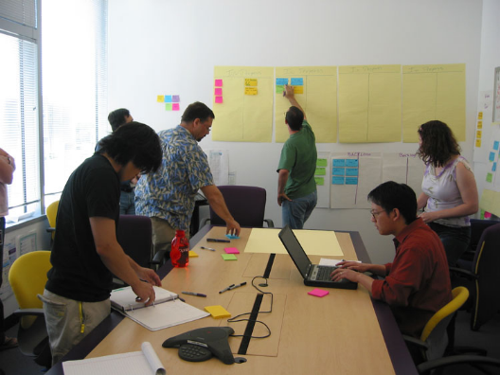
Daily Scrum Meeting
Parameters
  Daily, ~15 minutes, Stand-up
  Anyone late pays a $1 fee
Not for problem solving
  Whole world is invited
  Only team members, Scrum Master, product owner, can talk
  Helps avoid other unnecessary meetings
Three questions answered by each team member:
  What did you do yesterday?
  What will you do today?
  What obstacles are in your way?

Slide 12
Scrum's Artifacts
Scrum has remarkably few artifacts
  Product Backlog
  Sprint Backlog
  Burndown Charts
Can be managed using just an Excel spreadsheet
  More advanced / complicated tools exist:
    Expensive
    Web-based – no good for Scrum Master/project manager who travels
    Still under development

Slide 13

Product Backlog
The requirements
A list of all desired work on project
Ideally expressed as a list of user stories along with "story points", such that each item has value to users or customers of the product
Prioritized by the product owner
Reprioritized at start of each sprint
This is the
product backlog

Slide 14
Product Backlog
The product backlog contains rough estimates of both business value and development effort, these values are often stated in story points using a rounded Fibonacci sequence.
Those estimates help the Product Owner to gauge the timeline and may influence ordering of backlog items.
  Example, if the “add spellcheck” and “add table support” features have the same business value, the one with the smallest development effort will probably have higher priority, because the Return on Investment is higher.

Slide 15
User Stories
Instead of Use Cases, Agile project owners do "user stories"
  Who (user role) – Is this a customer, employee, admin, etc.?
  What (goal) – What functionality must be achieved/developed?
  Why (reason) – Why does user want to accomplish this goal?
As a [user role], I want to [goal], so I can [reason].
Example:
  "As a user, I want to log in, so I can access subscriber content."
story points: Rating of effort needed to implement this story
  common scales: 1-10, shirt sizes (XS, S, M, L, XL), etc.

Slide 16
Sample Product Backlog
Backlog item | Estimate
Allow a guest to make a reservation | 3 (story points)
As a guest, I want to cancel a reservation. | 5
As a guest, I want to change the dates of a reservation. | 3
As a hotel employee, I can run RevPAR reports (revenue-per-available-room) | 8
Improve exception handling | 8
... | 30
... | 50

Slide 17
Artifacts: Sprint Backlog
Sprint Backlog: list of work the Development Team must address during the next sprint.
List derived by selecting stories/features from the top of the product backlog until the Development Team feels it has enough work to fill the sprint.
History: Development Team should note velocity of previous Sprints (total story points completed from each of the last sprints stories) when selecting stories/features for the new sprint.
Use number as guide for "effort" they can complete.

Slide 18
Sprint Backlog
Individuals sign up for work of their own choosing
  Work is never assigned
Estimated work remaining is updated daily
Any team member can add, delete change sprint backlog
If work is unclear, define a sprint backlog item with a larger amount of time and break it down later

Slide 19
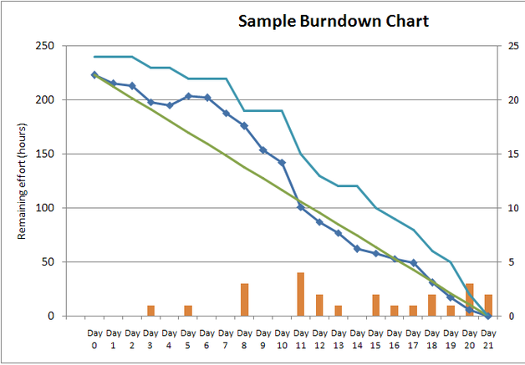
Sprint Burndown Chart
A display of what work has been completed
and what is left to complete
  one for each developer or work item
  updated every day
  (make best guess about hours/points completed each day)

Slide 20
Sample Sprint backlog
Tasks
Mon
Tue
Wed
Thu
Fri
Code the user interface
8
4
8
Code the middle tier
16
12
10
4
Test the middle tier
8
16
16
11
8
Write online help
12
Write the Foo class
8
8
8
8
8
Add error logging
8
4

Slide 21
Tasks
Mon
Tue
Wed
Thu
Fri
Code the user interface
8
4
8
Code the middle tier
16
12
10
7
Test the middle tier
8
16
16
11
8
Write online help
12
50
40
30
Hours
20
10
0
Mon
Tue
Wed
Thu
Fri

Slide 22
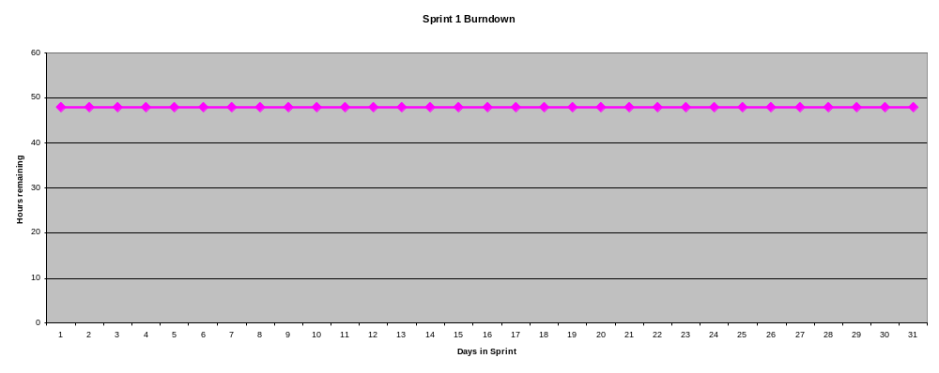
Burndown Example 1
No work being performed

Slide 23
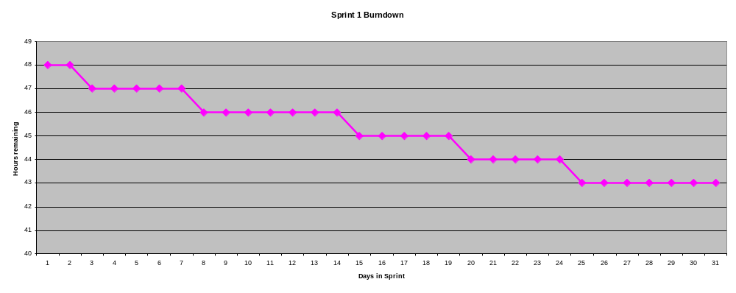
Burndown Example 2
Work being performed, but not fast enough

Slide 24
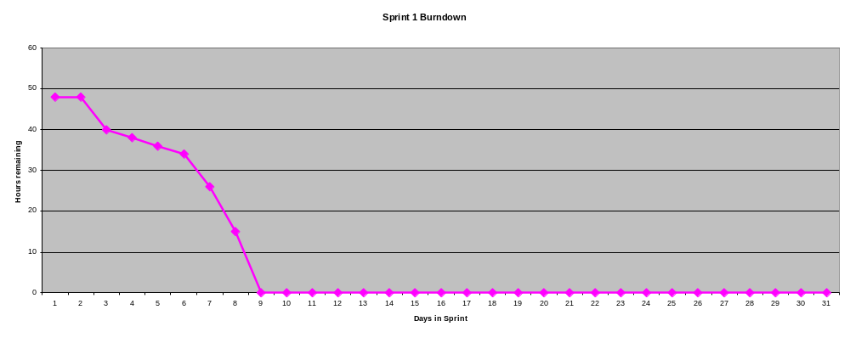
Burndown Example 3
Work being performed, but too fast!

Slide 25
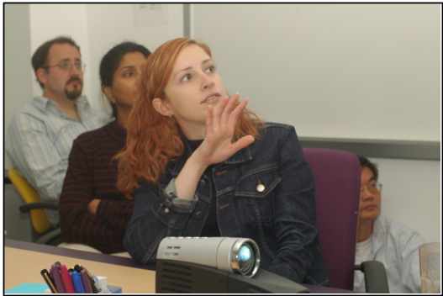
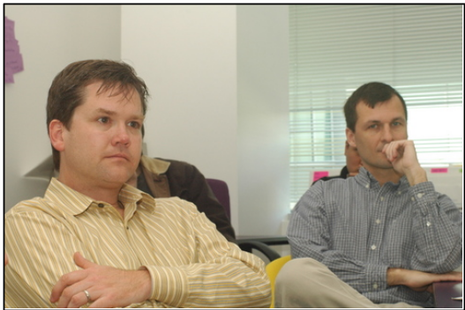
The Sprint Review
Team presents what it accomplished during the sprint
Typically takes the form of a demo of new features or underlying architecture
Informal
  2-hour prep time rule
  No slides
Whole team participates
Invite the world

Slide 26






Scaling: Scrum of Scrums

Slide 27

Credits, References
  Mike Cohn, Mountain Goat Software
  www.mountaingoatsoftware.com
  Scrum and The Enterprise by Ken Schwaber
  Succeeding with Agile by Mike Cohn
  Agile Software Development Ecosystems by Jim Highsmith
  Agile Software Development with Scrum by K. Schwaber and M. Beedle
  User Stories Applied for Agile Software Development by Mike Cohn
  www.agilescrum.com/
  www.objectmentor.com
  jeffsutherland.com/
  www.controlchaos.com/scrumwp.htm
  agilealliance.com/articles/articles/InventingScrum.pdf

